Slide 1

Enhancing Cattle Disease Detection Accuracy: A Fusion of VGG-16 and InceptionV3 for Simultaneous Diagnosis of LSD and FMD
Bangladesh University of Business and Technology (BUBT)
Presented by
Md. Akhlaq Hossain (19202103293)
Md. Zillur Rahman (19202103296)
Tamima Nisat (19202103309)
Al Rifat Hasan (19202103311)
Nasir Uddin (19202103316)
Supervised by
Mr. Md. Ashiqur Rahman
Assistant Professor
Dept of CSE, BUBT

Slide 2
Table of Contents
01
02
03
04
Introduction
Objective
Motivation
Literature Review
05
06
07
08
Methodology
Experimental Result
Limitation
Future Works

Slide 3
1
Introduction

Slide 4
01 | Highlights the importance of accurate disease detection in cattle, focusing on LSD and FMD.
02 | Both diseases have significant economic impacts on the livestock industry.
03 | 10% clinical prevalence of LSD and frequent outbreaks on farms, especially in female and crossbred cattle.
04 | Proposes a model Ensembling VGG16 and InceptionV3 for detecting Foot-and-Mouth Disease and Lumpy Skin Disease in cattle.

Slide 5
2
Objective
Notes:
https://docs.google.com/presentation/d/1_56MEbntyLFh_pr3wcu-2ylkZPb_3kOiuPnBD1ItMD4/edit?usp=sharing

Slide 6
01 | Proposes a model VGG16, Resnet50 and Inception V3 for detecting Foot-and-Mouth Disease and Lumpy Skin Disease in cattle.
02 | Demonstrates proficiency in accurately classifying diseases with a 90% test accuracy.
03 | Surpasses pre-trained models like VGG16, Resnet50, and InceptionV3 in accuracy.
04 | Analyzes various datasets using convolutional and recurrent networks.
05 | Demonstrates high levels of accuracy, sensitivity, and specificity making it a useful technique for disease surveillance and scalable livestock health management.
Notes:
Ensemble Model for Cattle Diseases:
Combining VGG16, Inception V3, and Inception to detect diseases.
90% Test Accuracy Proficiency:
Successfully classifying diseases with a high 90% accuracy rate.
Surpassing Pre-trained Models:
Outperforming VGG16, Resnet50, and InceptionV3 in disease detection accuracy.
Analyzing Datasets with Networks:
Evaluating data using convolutional and recurrent networks for accuracy.
High Accuracy, Sensitivity, Specificity:
Achieving precision, recall, and true negative rates for effective disease surveillance.
Useful for Scalable Livestock Health:
Applicable technique for scalable and efficient livestock health management practices.

Slide 7
3
Motivation

Slide 8
01 | Addressing Critical Agricultural Challenges
02 | Optimizing Resource Allocation
03 | Improving Animal Welfare
04 | Enhancing Global Food Security
05 | Advancing Veterinary Science
Notes:
We are addressing urgent agricultural challenges, optimizing resource allocation, ensuring animal care, providing reliable, nutritious food, enhancing global food security, contributing to advancements in veterinary medicine and science and improved animal welfare.

Slide 9
4
Literature Review

Slide 10
Author | Paper Name | Model | Dataset | Accuracy
G. Rai, Naveen, A. Hussain | A deep learning approach to detect lumpy skin disease in cows | VGG-16 , VGG-19, Inception-v3 | Lumpy Skin and Normal Skin | 92.5%
B. Jiang, Q. Wu | Flyolov3 deep learning for key parts of dairy cow body detection | YOLOV3 | Cow Image | 83.47%
Y. Qiao, M. Truman | Cattle segmentation and contour extraction based on mask r-cnn for precision livestock farming | R-CNN with ResNet | Cattle segmentation | 92%
Notes:
We are overall reviewed 25 existing paper .Here we represent 3 papers from that.In that we find they use ANN,YOLOV3, R-CNN .But they are only work in one or 2 class and also use only one model.Some authors are use 3 models but their dataset classes are only 2 . After review those paper we are decided to implement 6 classes of cattle disease.On the other hand we use combine model of VGG16 and Inceptionv3 for getting better accuracy. We use LSD ,FMD and healthy image of cattle

Slide 11
5
Methodology

Slide 12
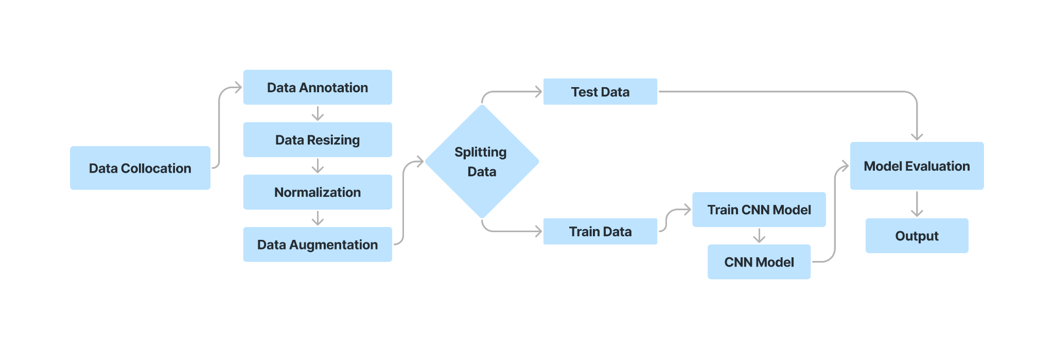
Data Collection & Analysis

Slide 13
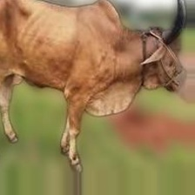
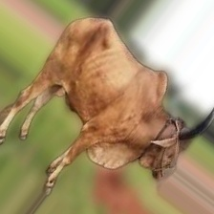
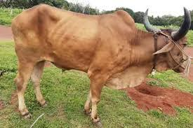
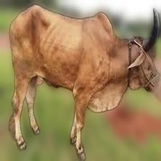
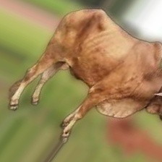
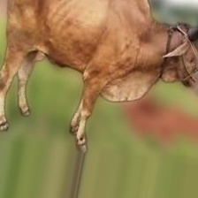
Data Preprocessing
Collected Image
Preprocessed Image
Augmented Image

Slide 14
Used Dataset
Datasource | Google & Kaggle
No of Class | 6
Total Image | 5104
Class | Test | Train | Val | Total
fmd_foot | 82 | 656 | 82 | 820
fmd_mouth | 88 | 704 | 88 | 880
healthy_foot | 84 | 672 | 84 | 840
healthy_mouth | 80 | 644 | 80 | 804
healthy_skin | 88 | 704 | 88 | 880
lsd_skin | 88 | 704 | 88 | 880
Total | 510 | 4084 | 510 | 5104

Slide 15
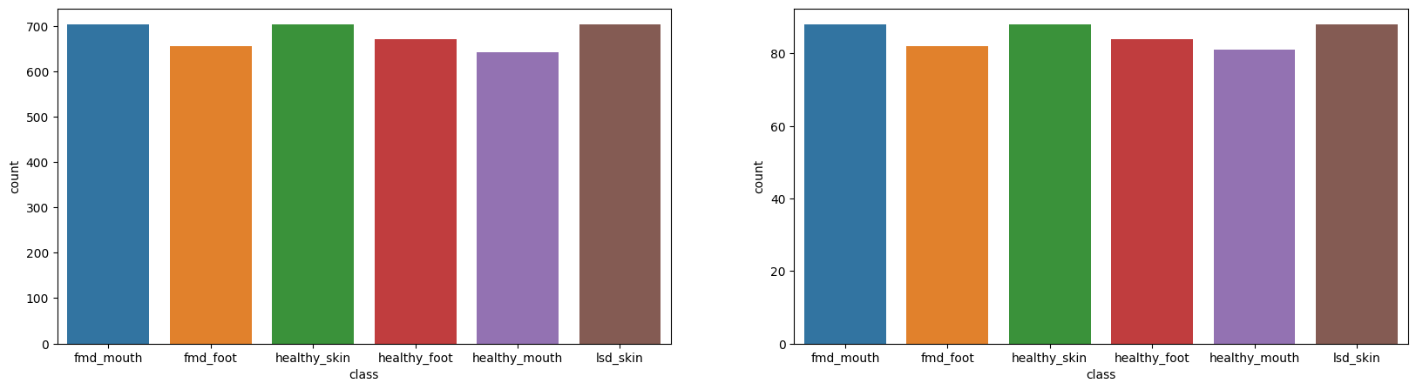
Testing
Training

Slide 16
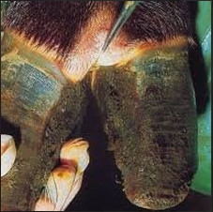
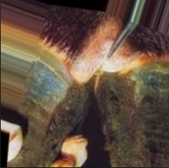
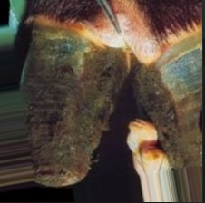
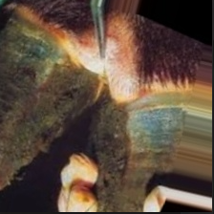
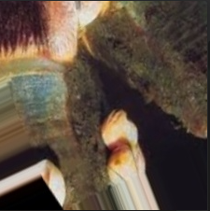
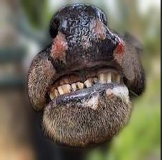
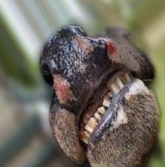
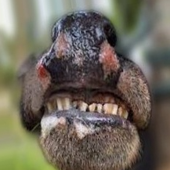
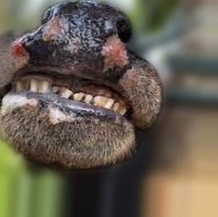
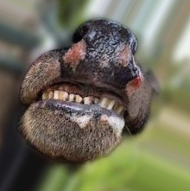
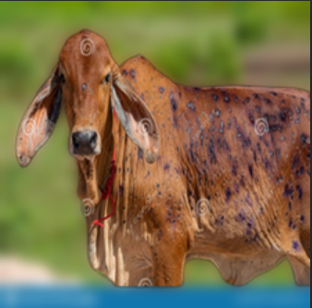
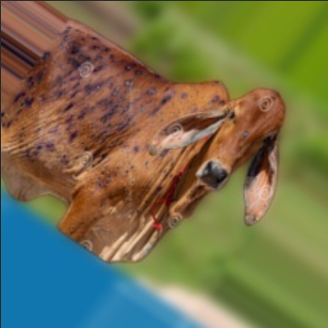
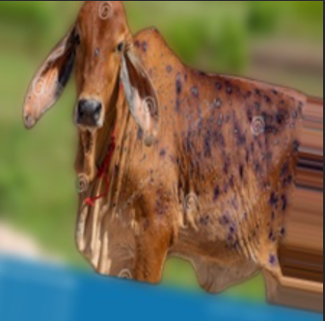
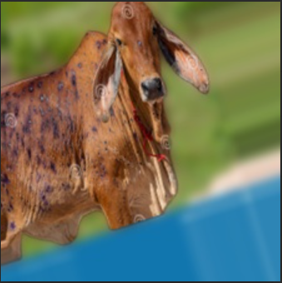
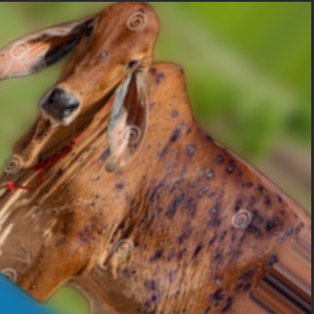
Diagram of Data Augmentation
FMD_FOOT
FMD_MOUTH
LSD_SKIN

Slide 17
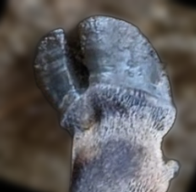
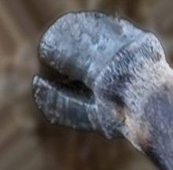
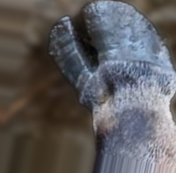
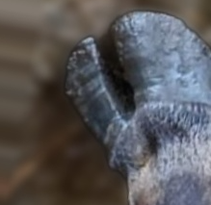
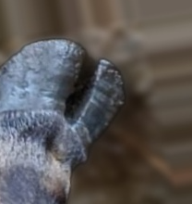
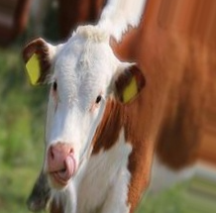
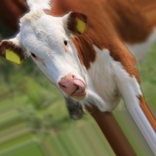
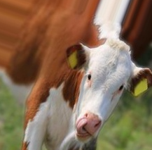
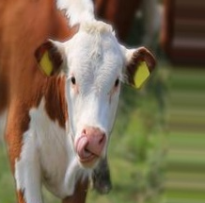
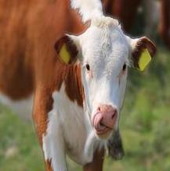
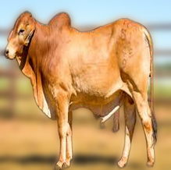
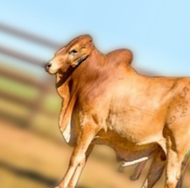
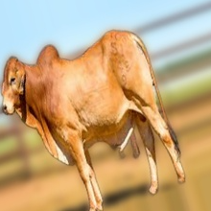
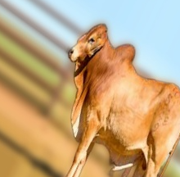
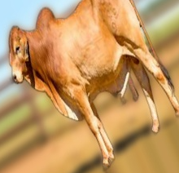
Diagram of Data Augmentation
HEALTHY_FOOT
HEALTHY_MOUTH
HEALTHY_SKIN

Slide 18
InceptionV3
Efficient Use of Parameters
Reduced Overfitting
Complexity and Interpretability
VGG-16 | 83.55%
ResNet-50 | 86.53%
InceptionV3 | 90.00%
Notes:
Efficient Use of Parameters: InceptionV3 introduces the concept of inception modules, which use different kernel sizes within the same layer to capture features at multiple scales. This allows for more efficient use of parameters compared to traditional architectures like VGG-16.
Reduced Overfitting: InceptionV3 incorporates techniques like batch normalization and dropout, which help prevent overfitting, making it more robust when trained on limited data.
Complexity and Interpretability: The architecture of InceptionV3 can be more complex to understand compared to VGG-16, which might make it challenging to interpret the learned features.

Slide 19
VGG-16
Simplicity and Uniformity
Good Feature Extraction
Limited Computational Resources
InceptionV3 | 90.00%
ResNet-50 | 86.53%
VGG-16 | 83.55%
Notes:
Simplicity and Uniformity: VGG-16 is known for its straightforward architecture, consisting of 16 convolutional layers with small 3x3 filters. This uniform structure makes it easier to understand and implement.
Good Feature Extraction: VGG-16 performs well in extracting hierarchical features from images, which is crucial for detecting patterns indicative of cattle diseases.
Limited Computational Resources: While VGG-16 provides good accuracy, its relatively large number of parameters can be computationally intensive, especially when dealing with large datasets or deploying models on resource-constrained devices.

Slide 20
ResNet-50
Addressing Vanishing Gradient Problem
Potential Performance
Increased Computational Complexity
InceptionV3 | 90.00%
VGG-16 | 83.55%
ResNet-50 | 86.53%
Notes:
Addressing Vanishing Gradient Problem: ResNet50 introduces skip connections, which mitigate the vanishing gradient problem encountered in deeper networks. This allows for training of much deeper architectures effectively.
State-of-the-Art Performance: ResNet50 has demonstrated state-of-the-art performance on various image classification tasks, indicating its potential for accurate cattle disease detection.
Increased Computational Complexity: While ResNet50 offers excellent performance, its deeper architecture requires more computational resources for training and inference compared to shallower networks like VGG-16.

Slide 21
Hyperparameter Tuning
Learning Rate | 0.005
Batch Size | 32
Number of Epochs | 60 ~ 80
Dropout Rate | 0.5
Optimizer | Adam
Activation Function | Softmax

Slide 22
6
Experimental Results

Slide 23
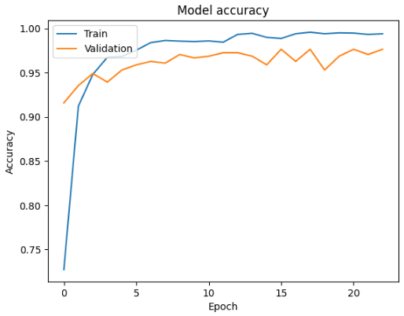
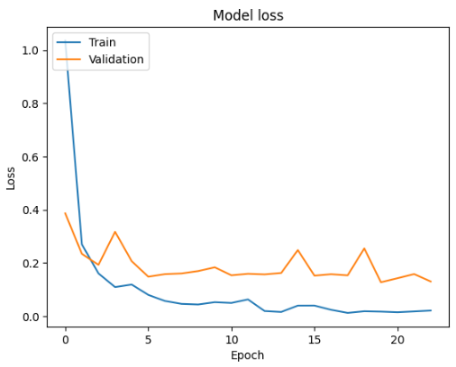
Model Accuracy & Loss
InceptionV3 | 90.00%
VGG-16 | 83.00%
InceptionV3

Slide 24
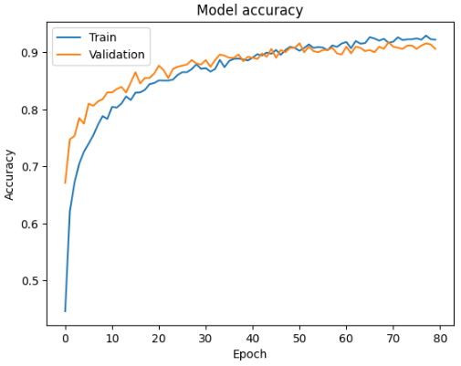
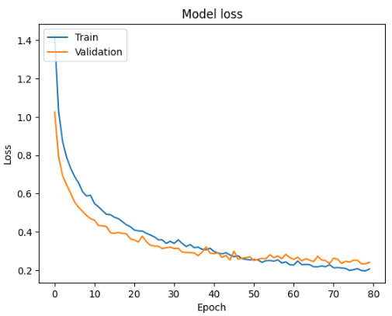
Model Accuracy & Loss
InceptionV3 | 90.00%
VGG-16 | 83.00%
VGG-16

Slide 25
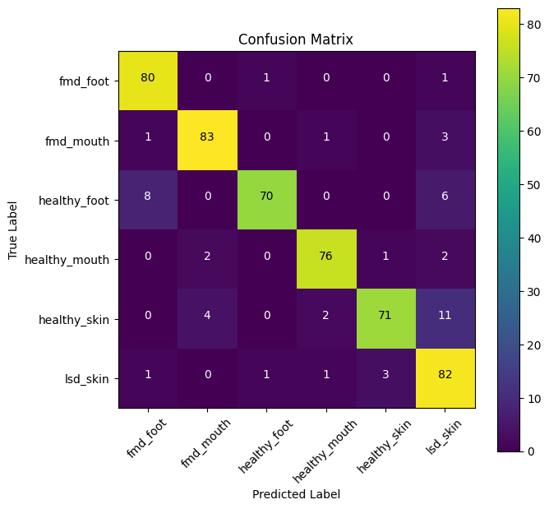
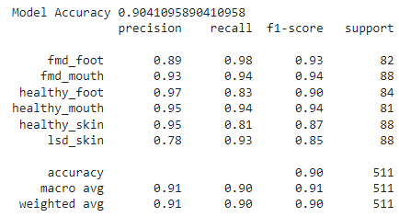
InceptionV3 - Confusion Matrix

Slide 26
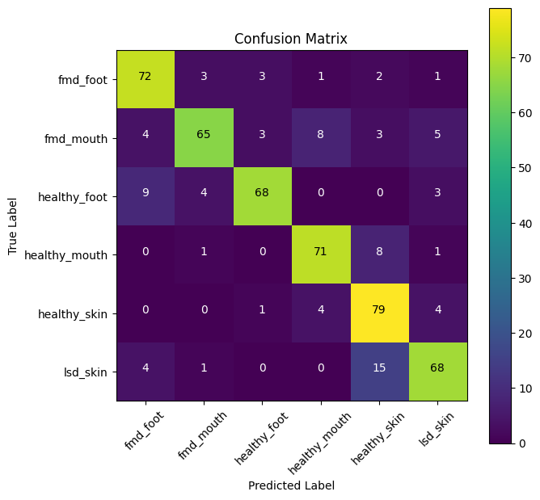
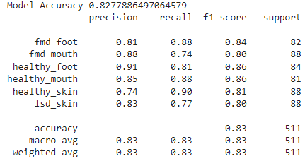
VGG-16 - Confusion Matrix

Slide 27
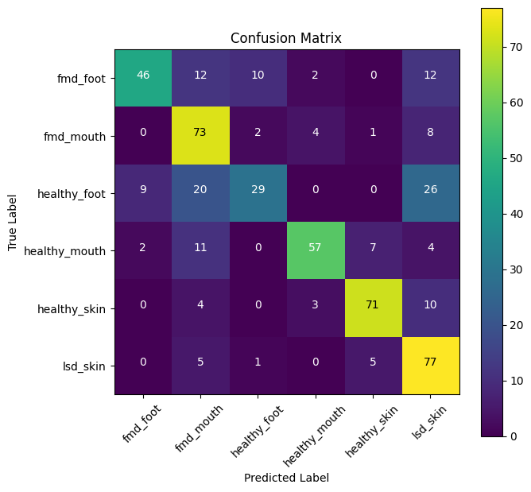
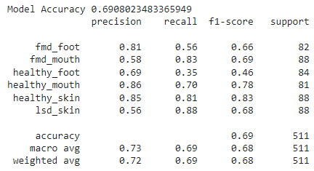
Resnet50 - Confusion Matrix

Slide 28

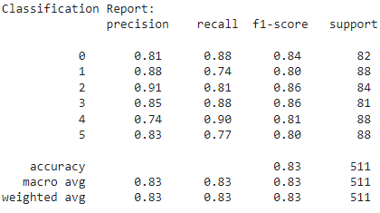
Ensemble VGG16 & InceptionV3- Confusion Matrix

Slide 29
7
Limitation

Slide 30
Dataset covers only three different cattle disease classifications
A
Includes quality images, images can be increased
Limitations
B
C
Data can be collected physically

Slide 31
8
Future Works

Slide 32

We will developed a mobile application
We will provide disease medicine
Notes:
Future works
we will develop a mobile application that saves a lot of time and money and makes use of technology that would be helpful to consumers.
we will evaluate different machine learning methods to automatically detect the symptoms of cattle diseases

Slide 33
Thank you!
Any Question?

